Slide 1
Human verification using one shot learning
Guided By –
Prof. Dinesh Naik
Presented By –
Nikhil Verma ( 222IT026 )

Slide 2
Introduction
Face verification is the task of comparing a candidate face to another and verifying whether it is a match. It is different from face recognition in a manner that in facial recognition is a one to many process, but facial verification is a one to one process where we match an image with the image of a person he is claiming to be.

Slide 3
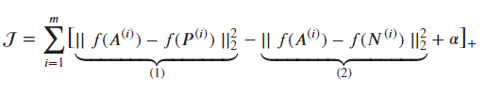
Methodology
Facial Recognition Model – the facial recognition model used in this project is Google FaceNet model which is trained on LFW dataset.
For calculating loss on training I am using Triplet Loss.
Triplet Loss Function uses three images to calculate loss, namely Anchor_image(A), Positive_image(P) and Negative_image(N).
The Triplet Loss Function is give by -

Slide 4
methodology
The FaceNet model trained for facial recognition is used to extract 128 dimensional vector of an image.
For verifying two images I have used a Siamese network architecture. In Siamese we pass images to be compared from the same network, we will get two 128 dimensional vetors. We use L1 norm to calculate distance between these two vectors and based on the distance we decide whether the input images are of same person or not.

Slide 5
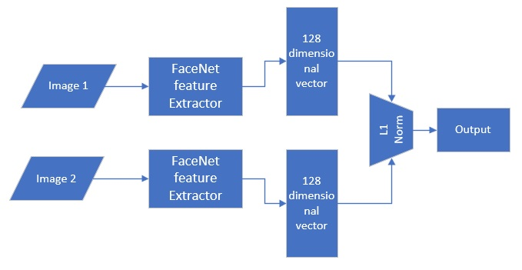
Siamese Network

Slide 6
Verification On Masked FAces
In a image where a person is wearing a face mask, the only distinct features are the part which are not covered by mask. So if using complete face image for verification the mask increases similarity between images.
For verifying image with face mask on we crop the images and give as input to the Siamese network model.
As there are less features in the image due to cropping we also need to increase the threshold distance to similar and dissimilar images.

Slide 7
conclusion
I have used 10 different persons image without face mask and 10 image with masked faces for testing and the model is performing accurately.

Slide 8
Thank You

